Slide 1

IE6700 DATABASE MANAGEMENT SYSTEMS

Slide 2

Patient Health Management System
‍💻 Team Name: Data Dynamos
👤 Team Members:
Muskan Sharma
Hemalikaa Thirumavalavan
Mohit Deshpande

Slide 3
CONTENTS
Dataset Purpose & Need
Relevance & Impact
EER Model
UML Class Diagram
Relational Model
SQL Query Implementation
Py-My-SQL Implementation
NoSQL Implementation
Project Summary and Key Learning

Slide 4
Purpose of the Dataset
Centralized healthcare data system
The system tracks patient interactions with both diagnoses along with prescriptions and labs and manages billing activities and ensures insurance coverage.
Why It’s Needed ?
Accurate, up-to-date patient records
Faster, safer diagnoses and treatment
Reduces errors & duplicate testing
Improves efficiency and care quality
Dataset Purpose & Need

Slide 5

Relevance & Impact
Real-World Relevance
Enhances patient outcomes
Supports data-driven decisions
Helps in demographic & public health analysis
Business Impact
Simplifies billing & insurance claims
Streamlines hospital workflows
Enables better resource planning

Slide 6
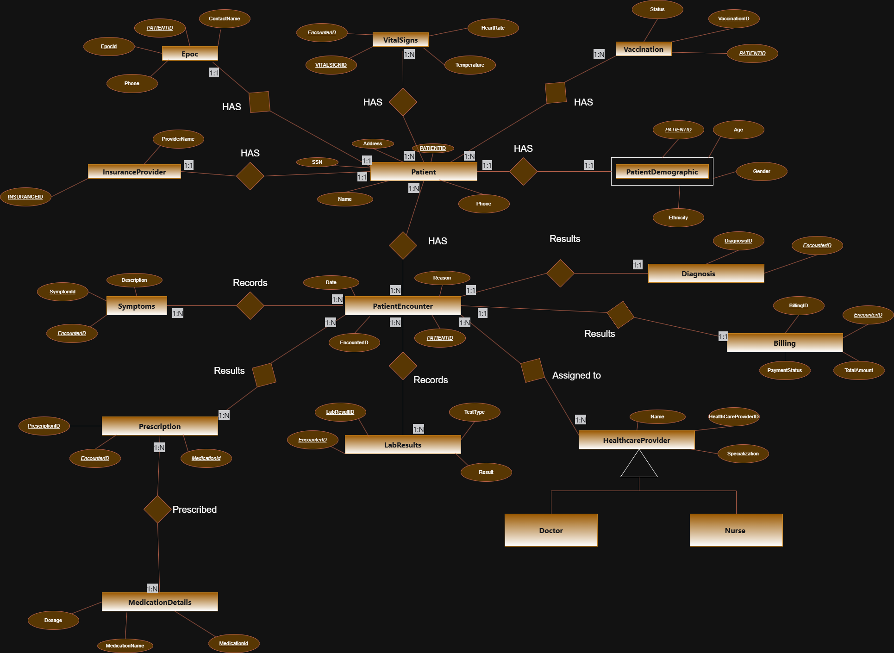
Figure 1: EER Model

Slide 7
Models hospital data using entities like Patient, Encounter, Diagnosis, and Billing.
Patient entity stores demographics, insurance, encounters, and vital signs.
Ensures data integrity with one-to-one and one-to-many relationships.
Tracks medical processes from symptoms to diagnosis, prescriptions, and billing.
Stores lab results, medications, and vaccine records securely in organized tables.
EER Model

Slide 8
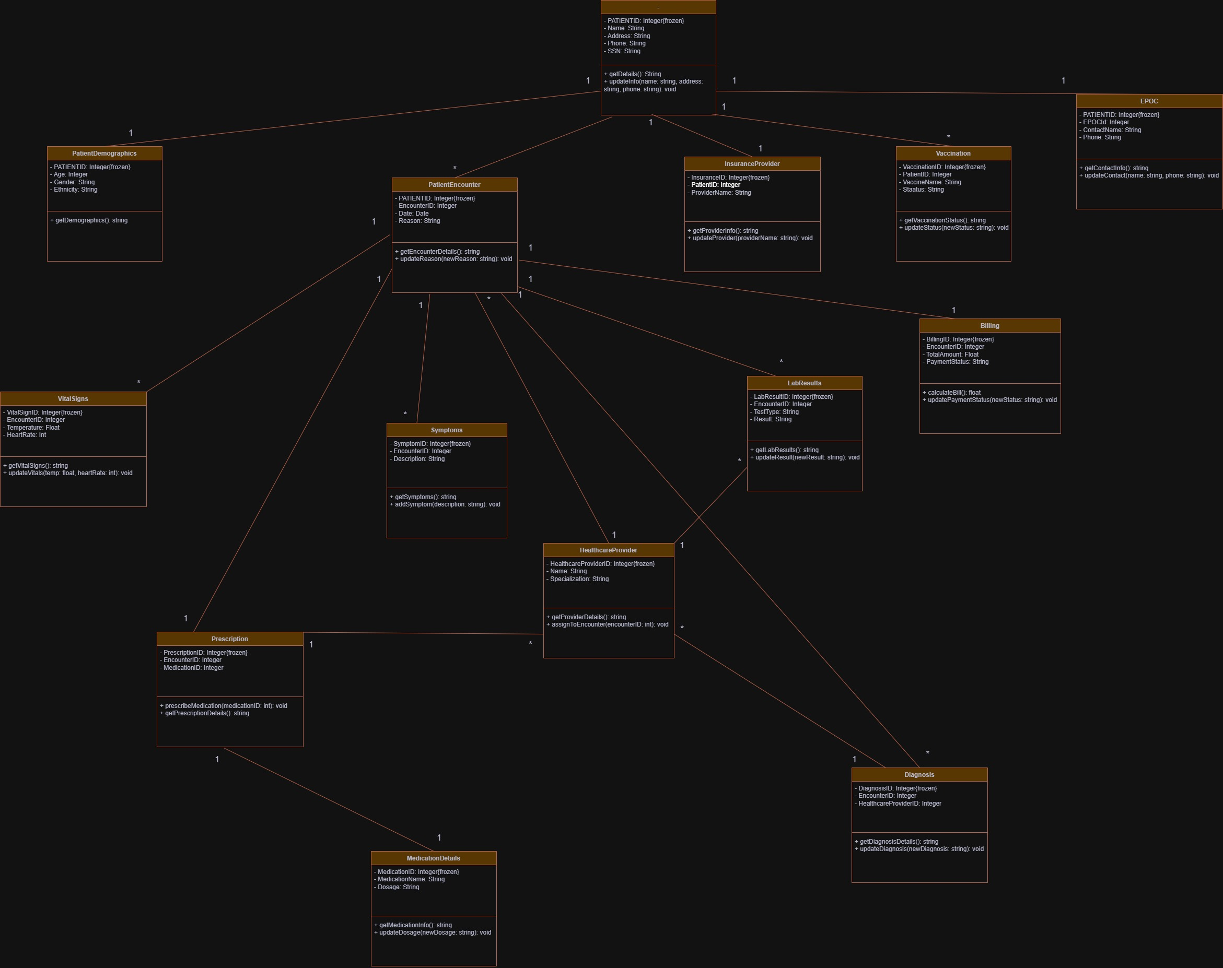
Figure 2:- UML Diagram

Slide 9
Represents hospital data using entities like Patient, Encounter, Diagnosis, and Billing.
Patient entity stores demographics, insurance, encounters, and vitals.
Ensures integrity with one-to-one and one-to-many relationships.
Maps medical flow from symptoms to diagnosis, prescriptions, and billing.
Organizes secure storage for lab results, medications, and vaccines.
UML Class Diagram

Slide 10

Relational Model
📊 Structured into tables for each entity (Patient, Encounter, Billing, etc.)
🔗 Relationships managed using foreign keys with cascading rules
✅ Ensures data integrity and consistency
🧱 Modular design: separates demographics, medical data, and administration
🔍 Optimized for query performance and analytics
🏥 Supports complete tracking of the patient care lifecycle

Slide 11

SQL Query Implementation
🗂️ Handles core hospital data operations using structured SQL queries
🏥 Tracks patient encounters with admission and discharge info
💵 Calculates billing summaries, such as total claim amount per encounter
🧾 Analyzes diagnosis data – count of unique conditions, condition-specific searches
👥 Manages emergency contacts and retrieves linked patient data
💊 Sorts medications by price, helping in prescription and inventory decisions
📈 Designed for efficient data retrieval and healthcare reporting
Notes:
This slide shows how we use SQL to manage our hospital data. Think of SQL as the engine that powers all our data needs.
What does our system do? First, it handles all our basic hospital information using SQL queries - that's like having a digital filing cabinet that's always organized.
It keeps track of patients from the moment they walk in until they leave. It also figures out billing totals for each patient visit, making our financial tracking much easier.
The system counts and searches through diagnosis information, helping doctors quickly find what they need. For emergencies, it pulls up patient contacts and history at a moment's notice.
We've even made it sort medications by price, which helps us make smarter decisions about prescriptions and what to keep in stock.
The whole thing is built to be fast and efficient - less time waiting for computer systems means more time for patient care. The chart you see in the background is just one example of how this system helps us visualize and understand our hospital data better.

Slide 12
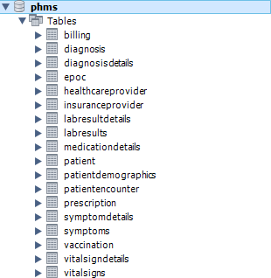
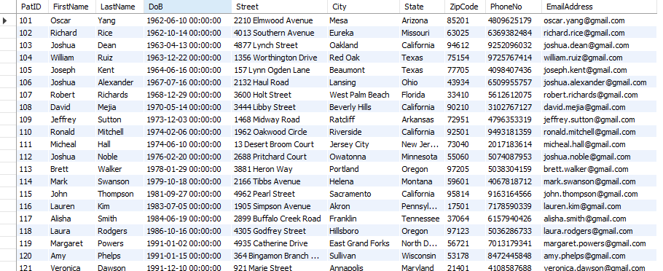
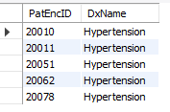
Find patients diagnosed with a specific condition (e.g., 'Hypertension').
SELECT d.PatEncID, dd.DxName FROM Diagnosis d JOIN DiagnosisDetails dd ON d.DxCode = dd.DxCode WHERE dd.DxName = 'Hypertension';

Slide 13
🐍 Used Python with SQL-Alchemy & PyMy-SQL for database interaction
📊 Loaded tables like Patient, Encounter, Billing, Diagnosis using Pandas
🧠 Data Analysis performed on:
Patient demographics (e.g., year of birth distribution)
Claim amounts based on payment status
Frequency of diagnoses
📈 Visualizations created using Matplotlib & Seaborn:
Histogram of birth years
Boxplot of claim amounts
Bar chart of top diagnoses
🧹Ensures efficient querying + clean visuals for healthcare insights
PyMy-SQL
Implementation
Notes:
Now let me walk you through how we implemented the technical side using PyMy-SQL.
I chose to work with Python combined with SQL-Alchemy and PyMy-SQL to handle our database needs. This gave us flexibility while maintaining solid database performance.
For our data work, I used Pandas to load important tables like Patient, Encounter, Billing, and Diagnosis information. Think of Pandas as our data workbench that organizes everything neatly.
We then analyzed three key areas: patient demographics, like how old our patients are; claim amounts based on whether they've been paid; and how often different diagnoses appear in our system.
To help everyone understand the data better, I created visualizations using Matplotlib and Seaborn - these are just tools that turn numbers into pictures. We made three main charts: a histogram showing patient birth years, a boxplot that displays claim amounts, and a bar chart highlighting our most common diagnoses.
The beauty of this approach is that it gives us both efficient database queries and clean, clear visuals. This means we get healthcare insights faster and in a way everyone can understand - whether you're technical or not.

Slide 14
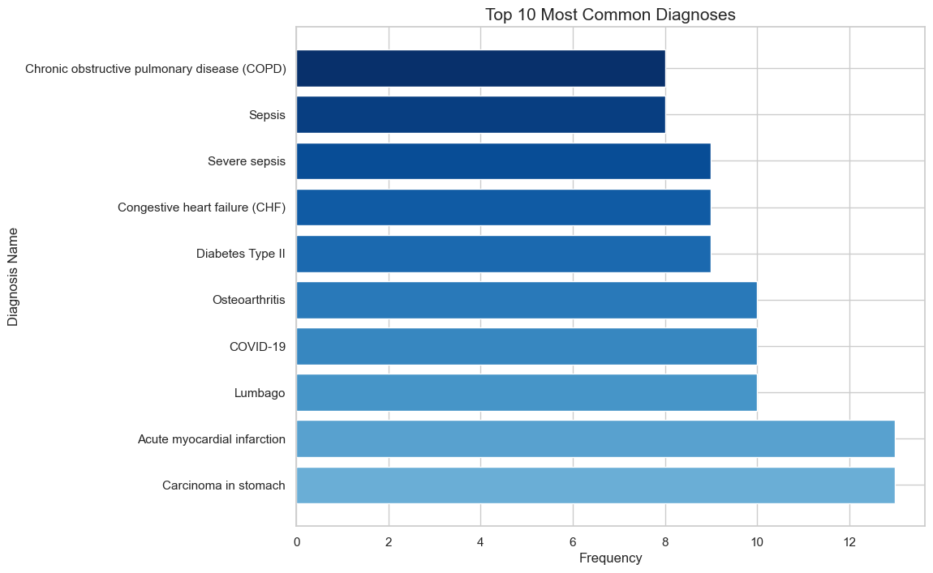
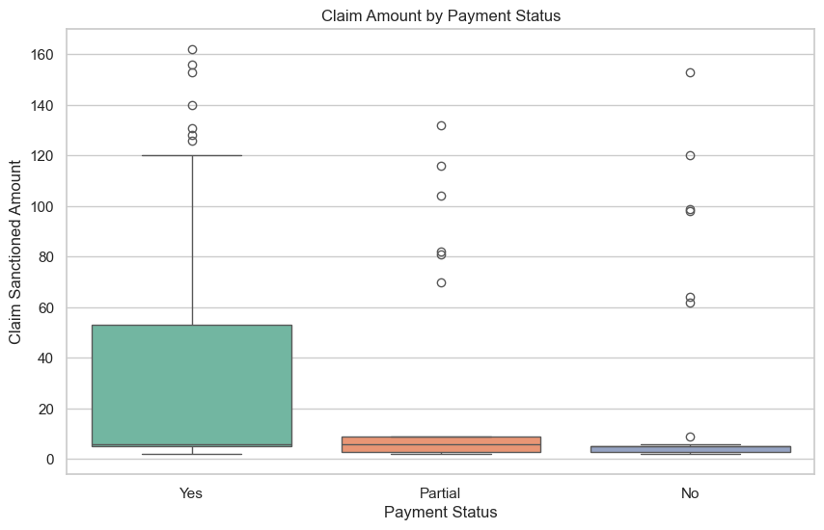
Top 10 Most Common Diagnose
Boxplot of Claim sactioned Amount for each Payment Status

Slide 15
🗃️ Implemented using MongoDB (document-based database)
📂 Used collections to store unstructured and semi-structured data
📌 Example Queries:
Patients from California
Patients with Blue Cross Blue Shield insurance
Patients who received a COVID booster
Cardiologists from provider data
Medications priced above $6
Pain-related symptoms from symptom records
Male patients vaccinated for COVID-19 or Influenza
⚡ Flexible schema supports dynamic healthcare data needs
NoSQL Implementation
Notes:
Now I'd like to show you our NoSQL implementation, which complements the SQL approach I just discussed.
For this part, I chose MongoDB, which is what we call a document-based database. Unlike traditional databases with rigid structures, MongoDB lets us store information more flexibly.
We organized our data into what MongoDB calls 'collections.' This approach was perfect for handling our unstructured and semi-structured data - things like clinical notes, image metadata, and patient-reported information that doesn't fit neatly into rows and columns.
Let me share some examples of the queries we can now run quickly. We can easily find all patients from California, identify those with specific insurance like Blue Cross Blue Shield, or locate patients who received a COVID booster. We can also pull lists of cardiologists from our provider data, find medications priced above $6, search for pain-related symptoms in our records, or identify male patients who received specific vaccinations.
The best part about this approach is the flexible schema. What that means in simple terms is that we can adapt to changing healthcare data needs without rebuilding the entire system. As medical knowledge evolves and reporting requirements change, our database can grow and change with them.

Slide 16
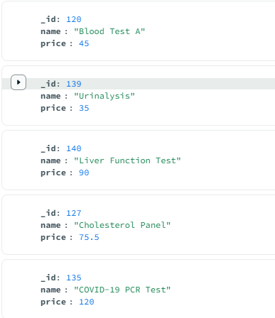
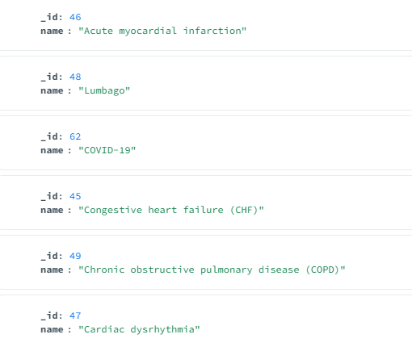
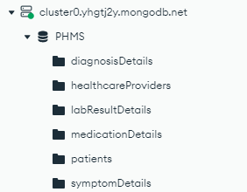

Slide 17

Project Summary & Key Learnings
✅ Designed a complete healthcare data system using EER, UML, and Relational Models
🧩 Built structured relationships between patients, encounters, billing, diagnoses, and medications
🧠 Executed real-world SQL queries to retrieve and analyze critical patient and billing data
📊 Performed analytics and visualizations using Python – identified diagnosis trends, payment patterns, etc.
📦 Used NoSQL (MongoDB) to support flexible, schema-less patient data handling
🔍 Learned how to:
Structure healthcare databases for real-time access and analytics
Ensure data integrity and reduce redundancy
Support operational needs (billing, reports, insights) in hospitals
🎯 Result: A functional and analytical patient health system that improves care, efficiency, and data-driven decision-making

Slide 19


